Slide 1
Network Protocols and Communication

Slide 2
Rules of Communication

Slide 3
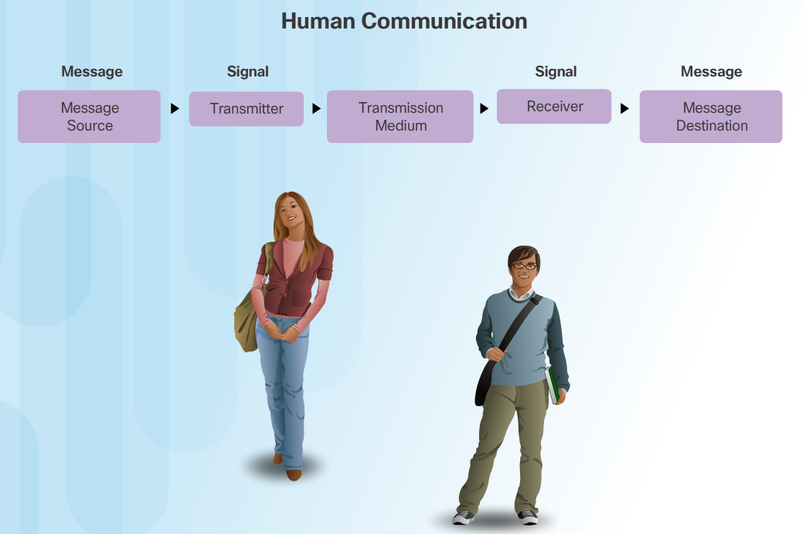
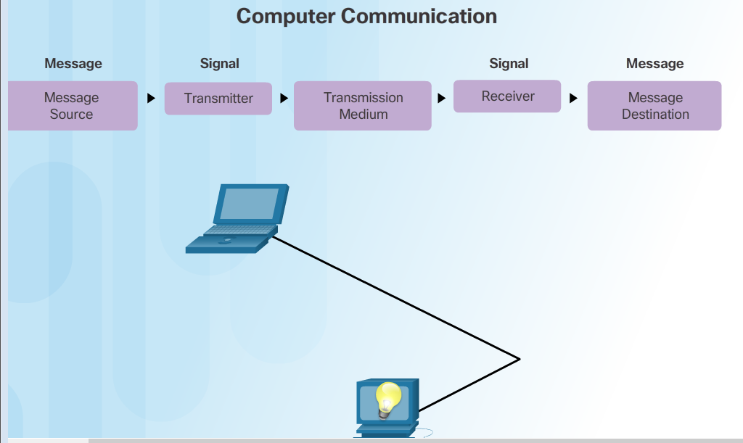
The Rules Communication Fundamentals
All communication methods have three elements in common:
Source or sender
Destination or receiver
Channel or media
Rules or protocols govern all methods of communication.

Slide 4
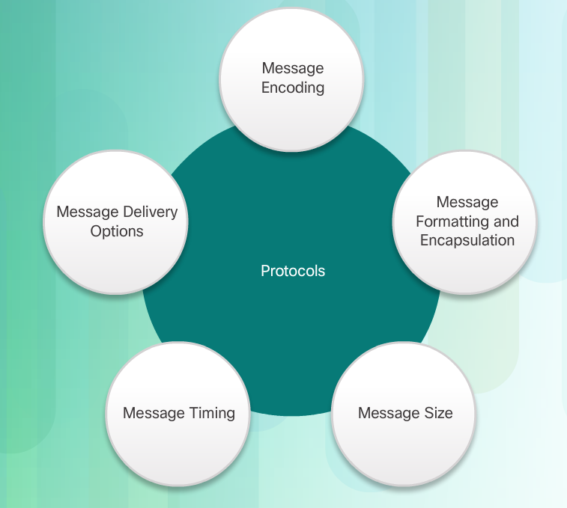
The Rules Rule Establishment
Protocols are necessary for effective communication and include:
An identified sender and receiver
Common language and grammar
Speed and timing of delivery
Confirmation or acknowledgment requirements
Protocols used in network communications also define:
Message encoding
Message delivery options
Message Formatting and Encapsulation
Message Timing
Message Size

Slide 5
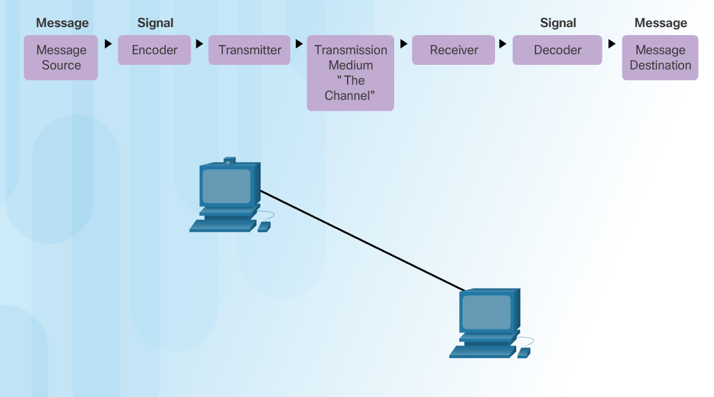
The Rules Message Encoding
Encoding between hosts must be in appropriate format for the medium.
Messages are first converted into bits by the sending host.
Each bit is encoded into a pattern of sounds, light waves, or electrical impulses depending on the network media
The destination host receives and decodes the signals in order to interpret the message.

Slide 6
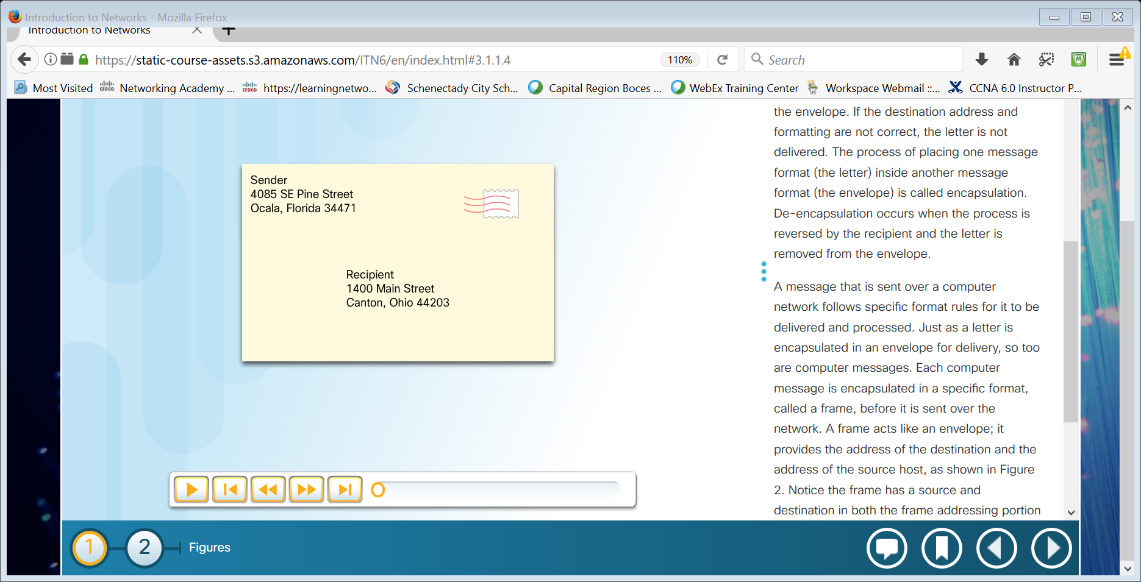
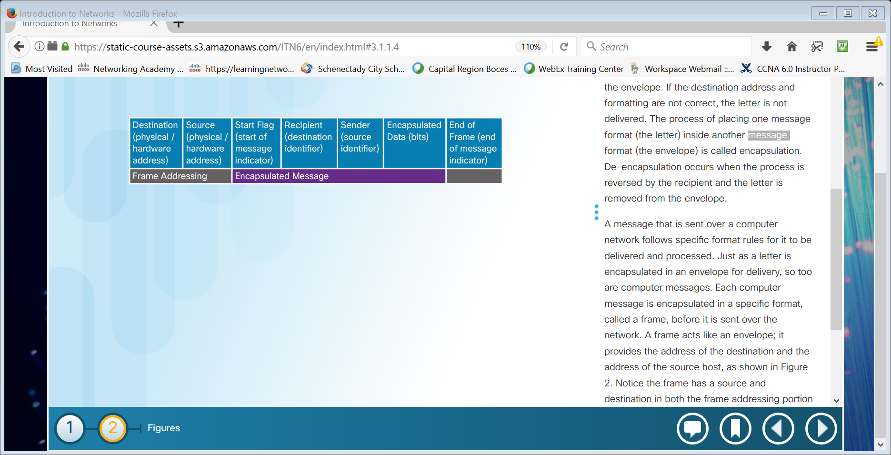
The Rules Message Formatting and Encapsulation
There is an agreed format for letters and addressing letters which is required for proper delivery.
Putting the letter into the addressed envelope is called encapsulation.
Each computer message is encapsulated in a specific format, called a frame, before it is sent over the network.
A frame acts like an envelope providing destination address and source address.

Slide 7
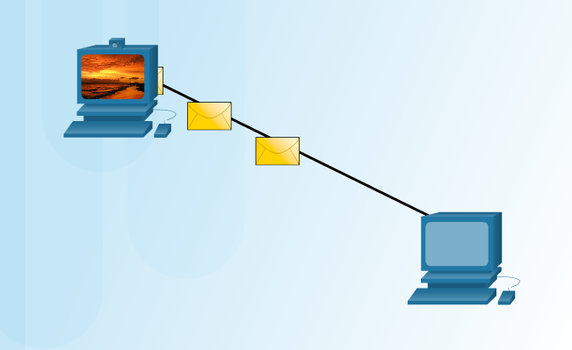
The Rules Message Size
Humans break long messages into smaller parts or sentences.
Long messages must also be broken into smaller pieces to travel across a network.
Each piece is sent in a separate frame.
Each frame has its own addressing information.
A receiving host will reconstruct multiple frames into the original message.

Slide 8
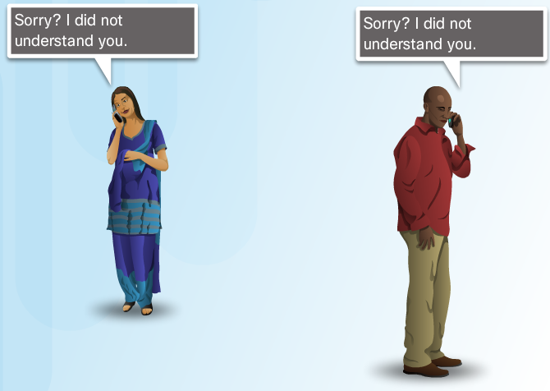
The Rules Message Timing
Access Method
Hosts on a network need to know when to begin sending messages and how to respond when collisions occur.
Flow Control
Source and destination hosts use flow control to negotiate correct timing to avoid overwhelming the destination and ensure information is received.
Response Timeout
Hosts on the network have rules that specify how long to wait for responses and what action to take if a response timeout occurs.

Slide 9
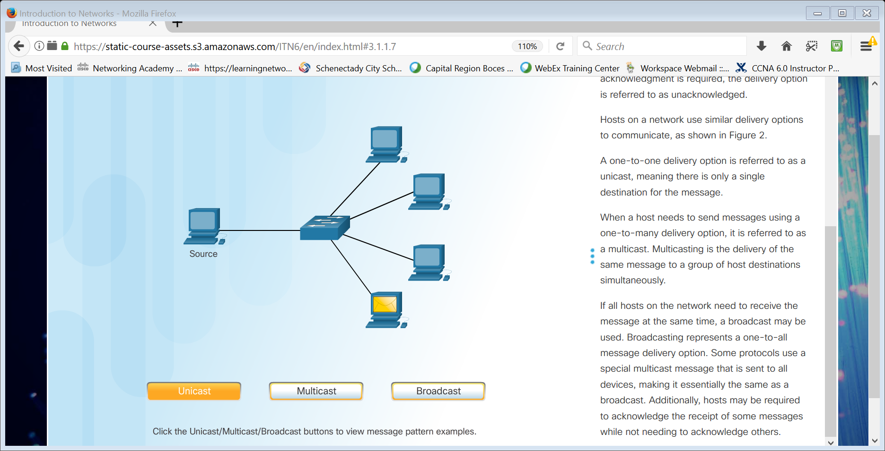
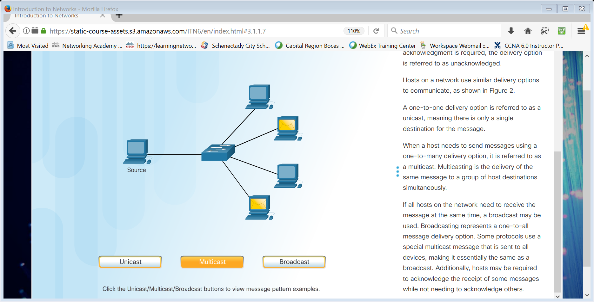
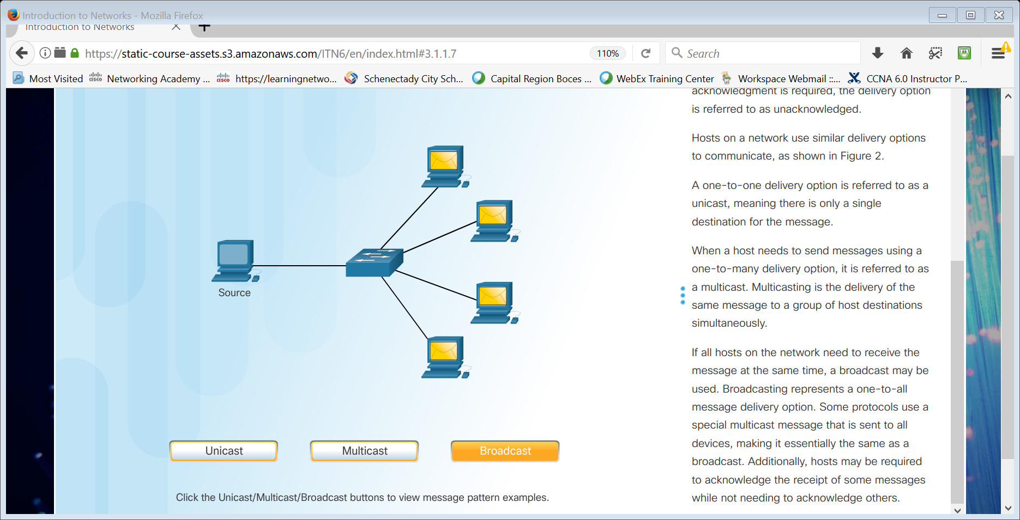
The Rules Message Delivery Options
Unicast Message Multicast Message Broadcast Message
One-to-one delivery
One-to-many delivery
One-to-all delivery

Slide 10
Network Protocols and Standards

Slide 11
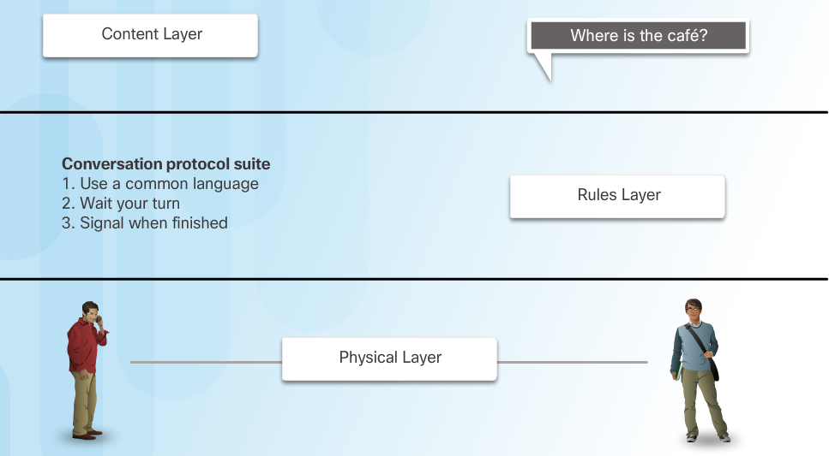
Protocols Rules that Govern Communications
Protocol suites are implemented by hosts and networking devices in software, hardware or both.
The protocols are viewed in terms of layers, with each higher level service depending on the functionality defined by the protocols shown in the lower levels.

Slide 12
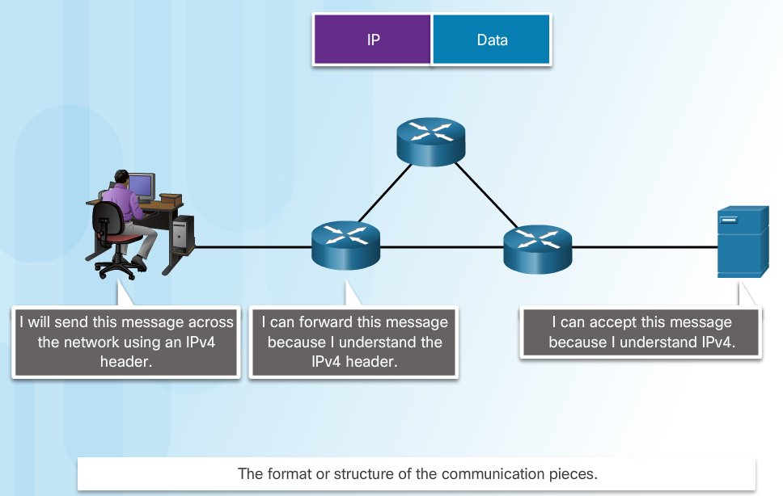
Protocols Network Protocols
Networking protocols define a common format and set of rules for exchanging messages between devices.
Some common networking protocols are Hypertext Transfer Protocol (HTTP), Transmission Control Protocol (TCP), and Internet Protocol (IP).

Slide 13
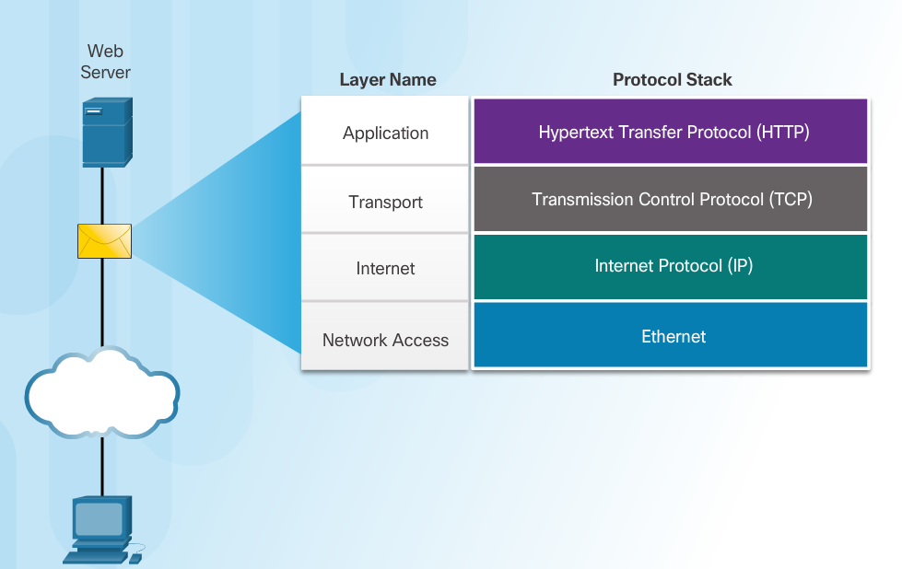
Protocols Protocol Interaction
Communication between a web server and web client is an example of an interaction between several protocols:
HTTP - an application protocol that governs the way a web server and a web client interact.
TCP - transport protocol that manages the individual conversations.
IP – encapsulates the TCP segments into packets, assigns addresses, and delivers to the destination host.
Ethernet - allows communication over a data link and the physical transmission of data on the network media.

Slide 14
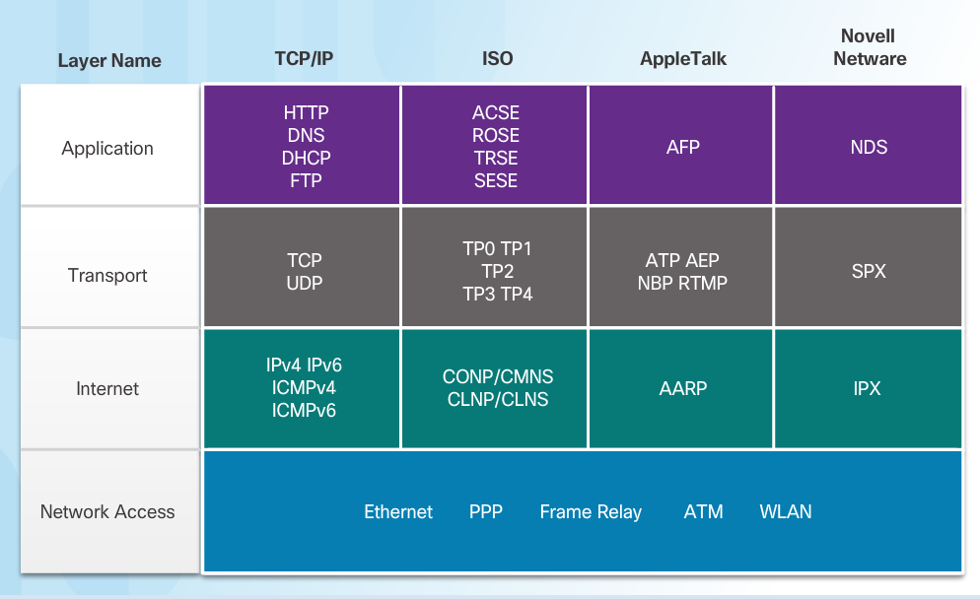
Protocol Suites Protocol Suites and Industry Standards
This course will only cover the protocols of the TCP/IP protocol suite
A protocol suite is a set of protocols that work together to provide comprehensive network communication services.
May be specified by a standards organization or developed by a vendor.
The TCP/IP protocol suite is an open standard, the protocols are freely available, and any vendor is able to implement these protocols on their hardware or in their software.

Slide 15
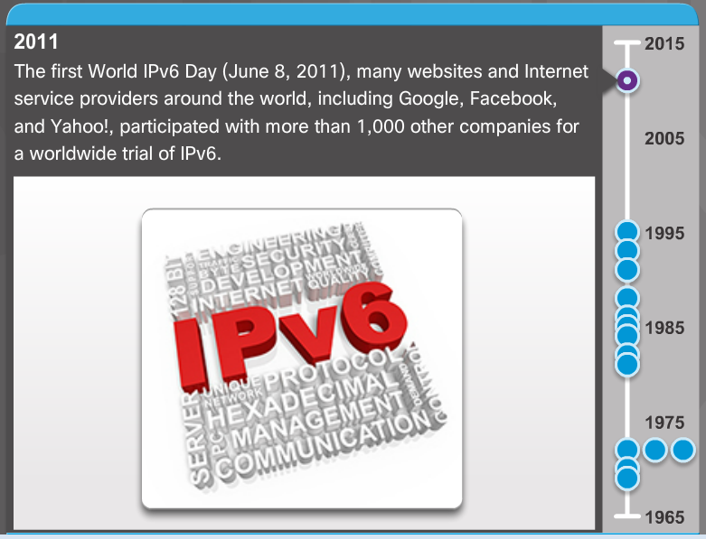
Protocol Suites Development of TCP/IP
Advanced Research Projects Agency Network (ARPANET) was the predecessor to today’s Internet.
ARPANET was funded by the U.S. Department of Defense for use by universities and research laboratories.

Slide 16
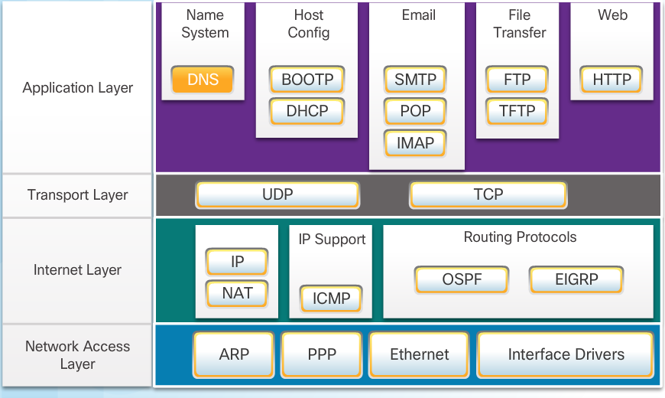
Protocol Suites TCP/IP Protocol Suite

Slide 17
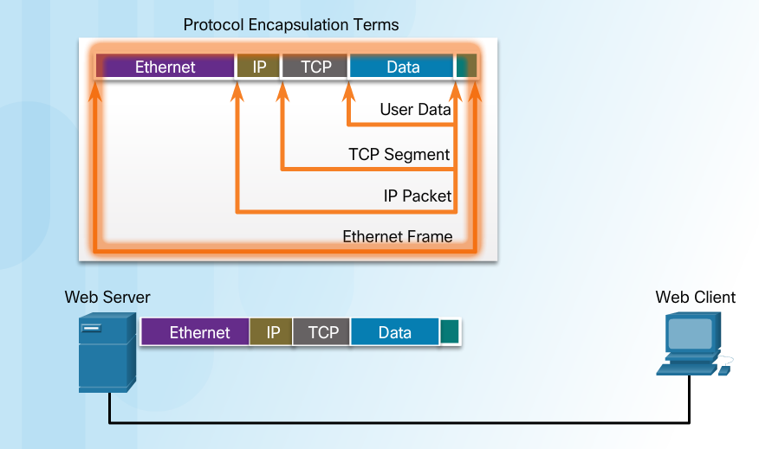
Protocol Suites TCP/IP Communication Process
When sending data from a web server to a client the encapsulation procedure would be as follows:
The webserver prepares the Hypertext Markup Language (HTML) page. The HTTP application layer protocol sends the data to the transport layer.
The transport layer breaks the data into segments and identifies each.
Next the IP source and destination addresses are added, creating an IP Packet.
The Ethernet information is then added creating the Ethernet Frame, or data link frame.
This frame is delivered to the nearest router along the path towards the web client. Each router adds new data link information before forwarding the packet.

Slide 18
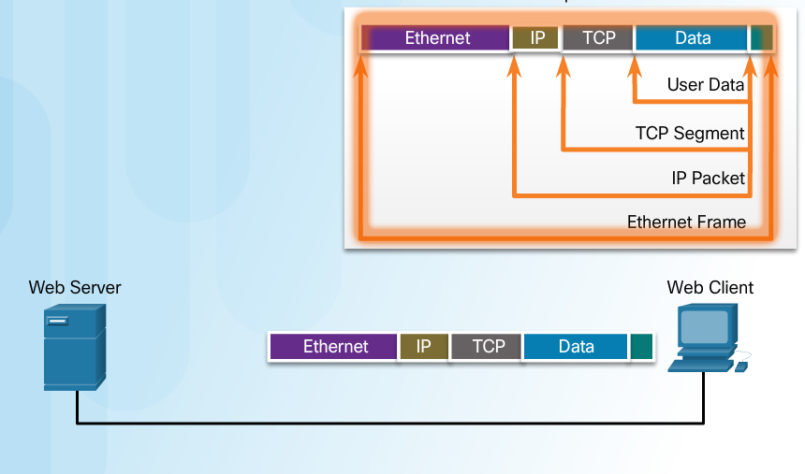
Protocol Suites TCP/IP Communication Process (Cont.)
When receiving the data link frames from the web server, the client processes and removes each protocol header in the opposite order it was added:
First the Ethernet header is removed
Then the IP header
Then the Transport layer header
Finally the HTTP information is processed and sent to the client’s web browser

Slide 19
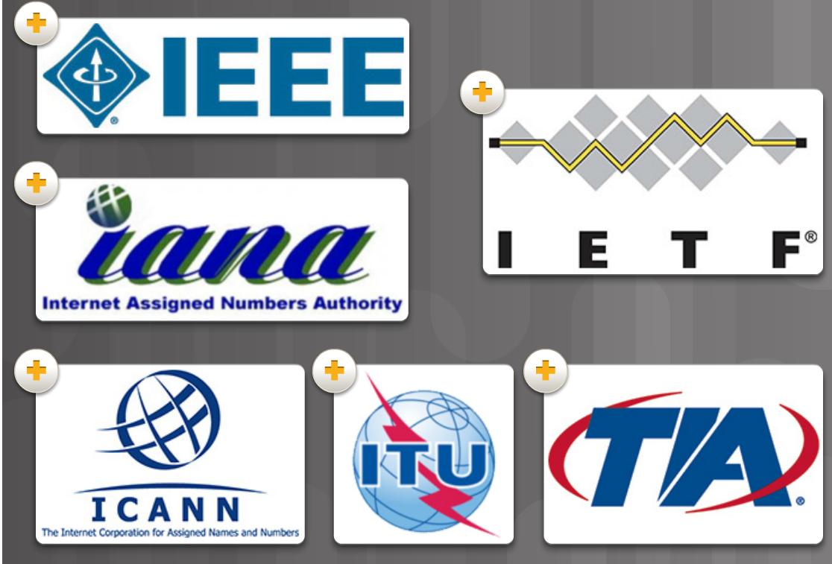
Standards Organizations Open Standards
Open standards encourage interoperability, competition, and innovation.
Standards organizations are usually vendor-neutral, non-profit organizations established to develop and promote the concept of open standards.

Slide 20
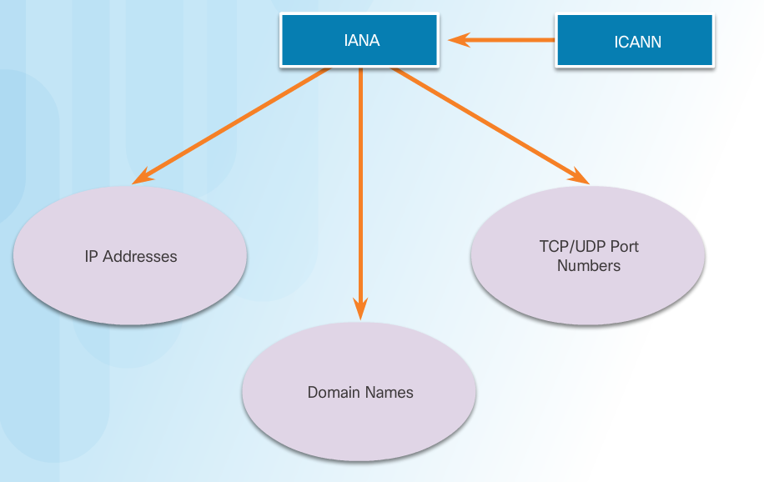
Standards Organizations Internet Standards
Internet Society (ISOC) –promotes open development and evolution of Internet use globally.
Internet Architecture Board (IAB) - management and development of Internet standards.
Internet Engineering Task Force (IETF) - develops, updates, and maintains Internet and TCP/IP technologies.
Internet Research Task Force (IRTF) - focused on long-term research related to Internet and TCP/IP protocols.
Internet Corporation for Assigned Names and Numbers (ICANN) - coordinates IP address allocation and management of domain names.
Internet Assigned Numbers Authority (IANA) - manages IP address allocation, domain name management, and protocol identifiers for ICANN.

Slide 21
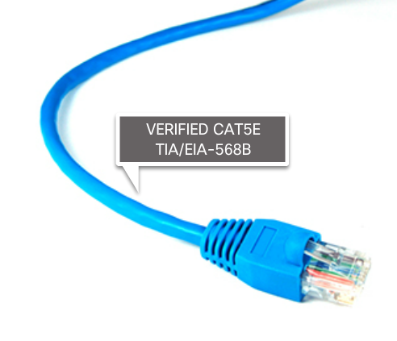
Standards Organizations Electronics and Communications Standard Organizations
Institute of Electrical and Electronics Engineers (IEEE) - dedicated to advancing technological innovation and creating standards in a wide area of industries including networking.
Electronic Industries Alliance (EIA) - standards related to electrical wiring, connectors, and network racks.
Telecommunications Industry Association (TIA) standards for radio equipment, cellular towers, Voice over IP (VoIP) devices, and satellite communications.
International Telecommunications Union-Telecommunication Standardization Sector (ITU-T) standards for video compression, Internet Protocol Television (IPTV), and broadband communications.

Slide 22
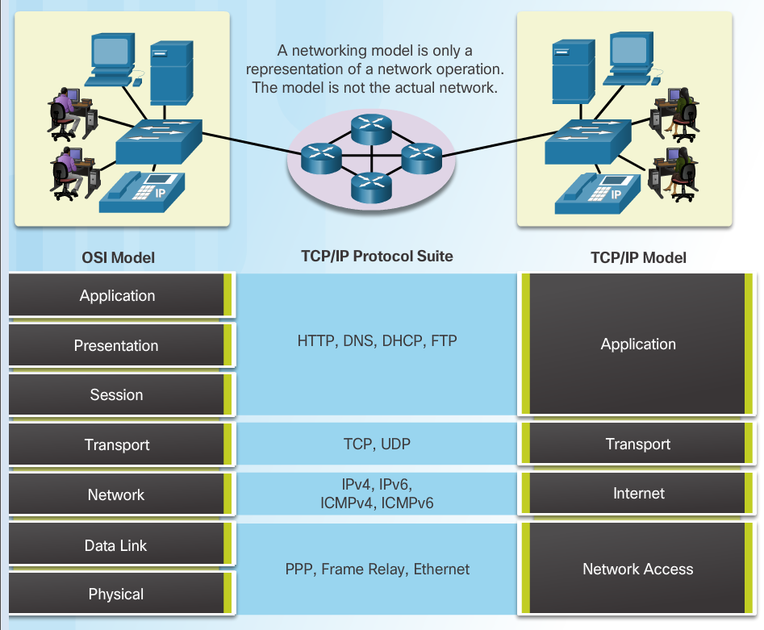
Reference Models The Benefits of Using a Layered Model
The benefits of using a layered model include:
Assisting in protocol design since protocols at each layer have defined functions.
Fostering competition because products from different vendors can work together.
Preventing technology changes in one layer from affecting other layers.
Providing a common language to describe networking functions and capabilities.

Slide 23
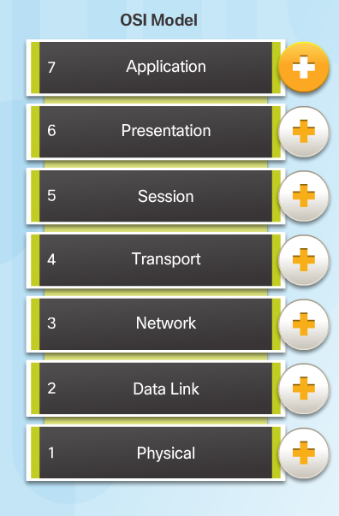
Reference Models The OSI Reference Model
Application - contains protocols used for process-to-process communications.
Presentation - provides for common representation of the data.
Session - provides services to the presentation layer to organize its dialogue and to manage data exchange.
Transport - defines services to segment, transfer, and reassemble the data.
Network - provides services to exchange the individual pieces of data over the network between identified end devices.
Data Link - provides methods for exchanging data frames between devices over a common media.
Physical - describes the mechanical, electrical, functional, and procedural means to transmit bits across physical connections.

Slide 24
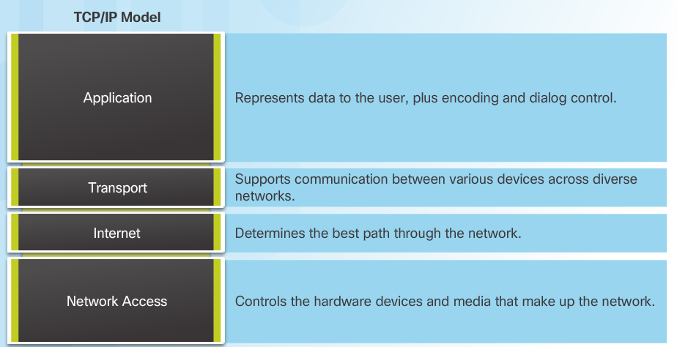
Reference Models The TCP/IP Protocol Model
The TCP/IP Protocol Model
Created in the early 1970s for internetwork communications.
Open Standard.
Also called The TCP/IP Model or the Internet Model.

Slide 25
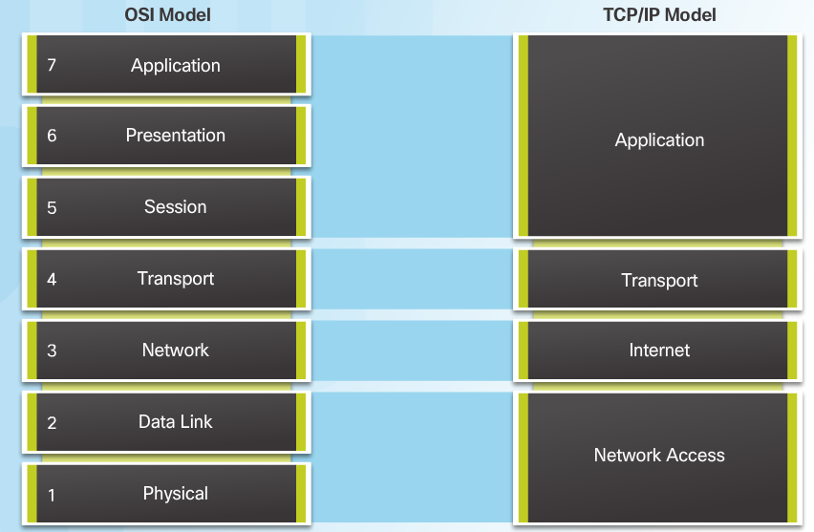
Reference Models OSI Model and TCP/IP Model Comparison
In the OSI model, the network access layer and the application layer of the TCP/IP model are further divided to describe discrete functions that must occur at these layers.

Slide 26
Data Transfer in the Network

Slide 27
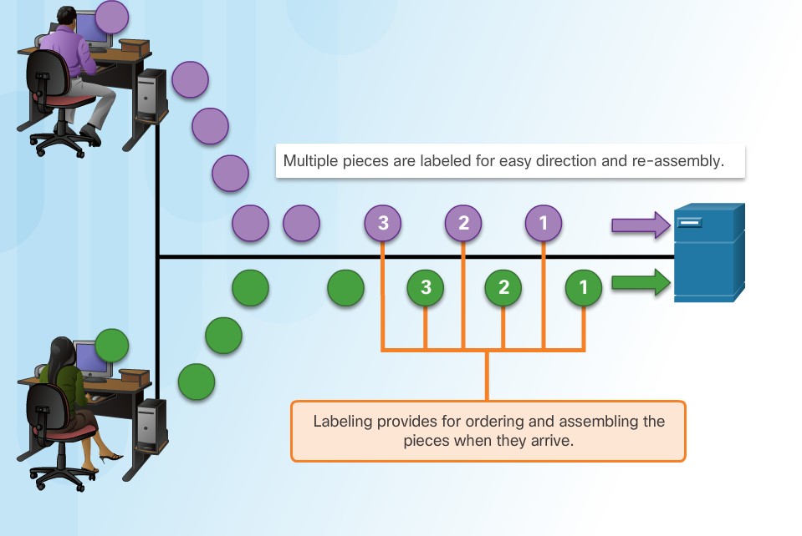
Data Encapsulation Message Segmentation
Large streams of data are divided into smaller, more manageable pieces to send over the network.
By sending smaller pieces, many different conversations can be interleaved on the network, called multiplexing.
Each piece must be labeled.
If part of the message fails to make it to the destination, only the missing pieces need to be retransmitted.

Slide 28
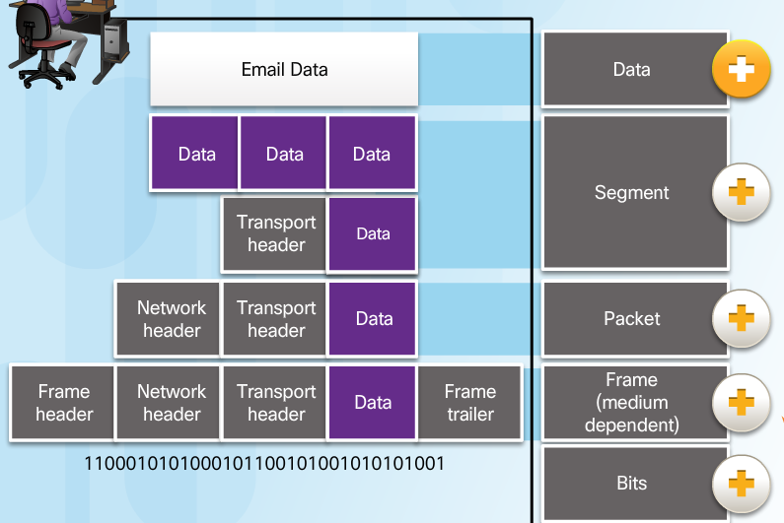
Data Encapsulation Protocol Data Units
As application data is passed down the protocol stack, information is added at each level. This is known as the encapsulation process.
The form that the data takes at each layer is known as a Protocol Data Unit (PDU).
Data - application layer PDU
Segment – Transport layer PDU
Packet – Network layer PDU
Frame – Data Link Layer PDU
Bits – Physical Layer PDU

Slide 29
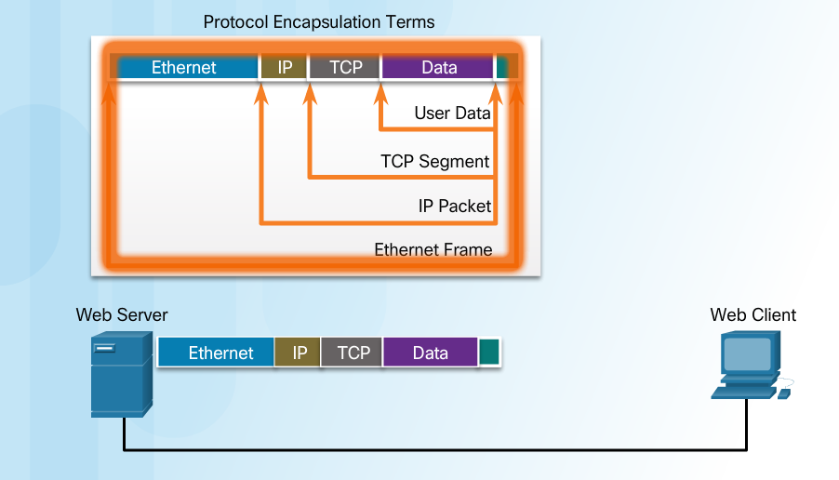
Data Encapsulation Encapsulation Example
The encapsulation process works from top to bottom:
Data is divided into segments.
The TCP segment is encapsulated in the IP Packet.
The IP packet is encapsulated in the Ethernet Frame.

Slide 30
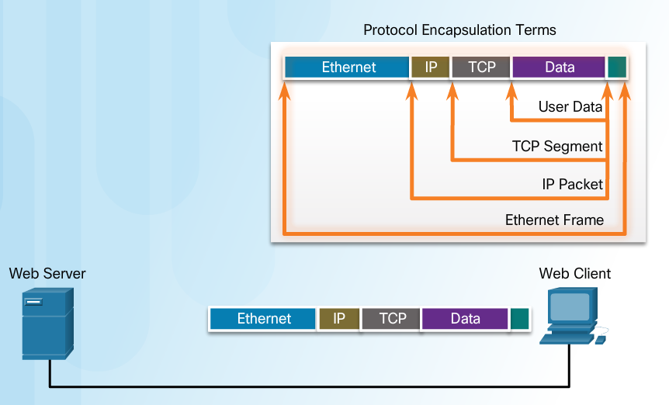
Data Encapsulation De-encapsulation
The de-encapsulation process works from bottom to top.
De-encapsulation is the process used by a receiving device to remove one or more of the protocol headers.
The data is de-encapsulated as it moves up the stack toward the end-user application.

Slide 31
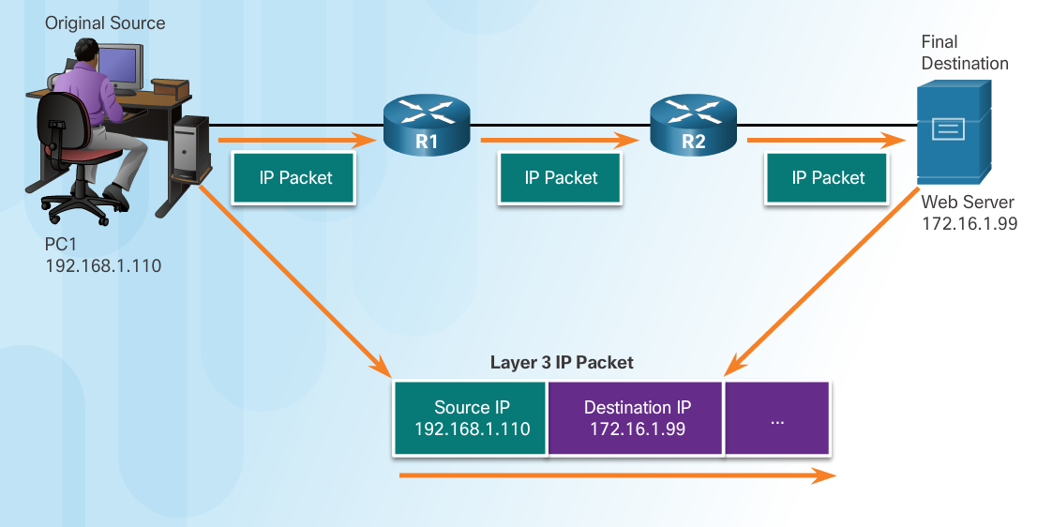
Data Access Network Addresses
Network layer source and destination addresses - Responsible for delivering the IP packet from the original source to the final destination.
Source IP address - The IP address of the sending device, the original source of the packet.
Destination IP address - The IP address of the receiving device, the final destination of the packet.

Slide 32
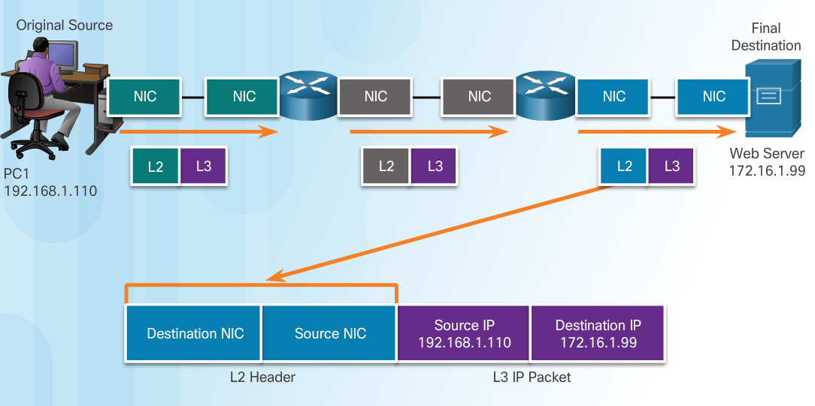
Data Access Data Link Addresses
The purpose of the data link address is to deliver the data link frame from one network interface to another network interface on the same network.
As the IP packet travels from source to destination it is encapsulated in a new data link frame when it is forwarded by each router.

Slide 33
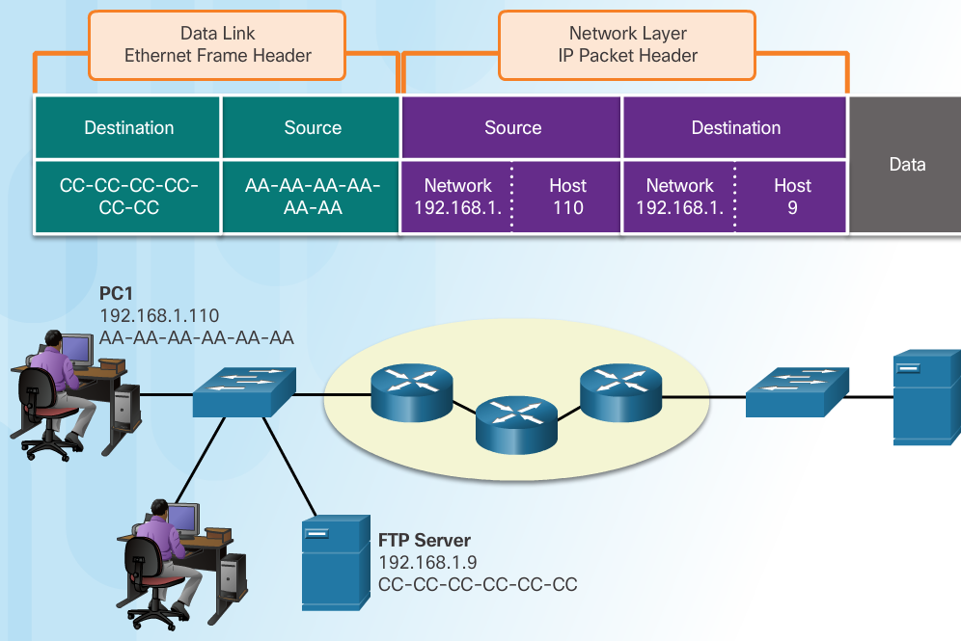
Data Access Devices on the Same Network
The network layer addresses, or IP addresses, indicate the original source and final destination.
Network portion – The left-most part of the address indicates which network the IP address is a member of.
Host portion – The remaining part of the address identifies a specific device on the network.
The data link frame which uses MAC addressing, is sent directly to the receiving device.
Source MAC address - address of sending device.
Destination MAC address – address of receiving device.

Slide 34
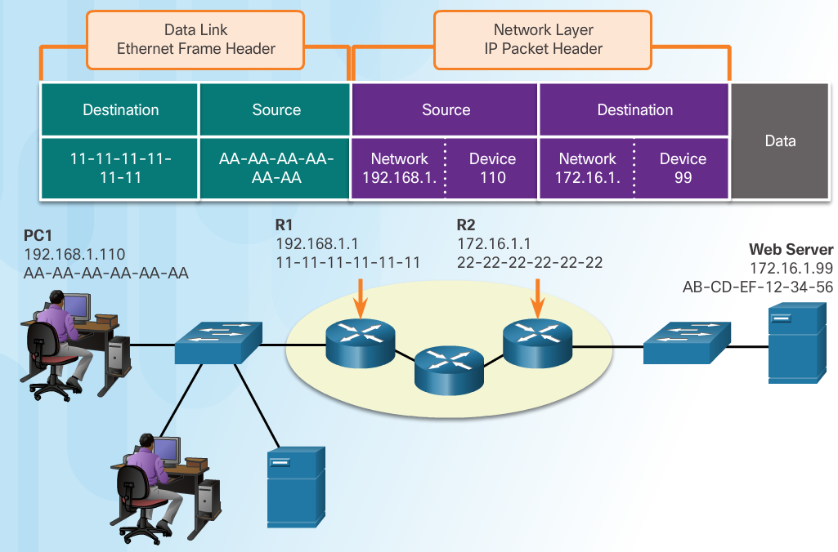
Data Access Devices on a Remote Network
Sending to a remote network - the source and destination IP addresses represent hosts on different networks.
The data link frame cannot be sent directly to the remote destination host. Therefore the frame is sent to the default gateway (nearest router interface).
The router removes the received Layer 2 information and adds new data link information before forwarding out the exit interface.

Slide 35
Subnetting IP Networks
CCNA Routing and Switching
Introduction to Networks v6.0
Notes:
Cisco Networking Academy Program
Introduction to Networks v6.0
Chapter 8: Subnetting IP Networks

Slide 36
Subnetting an IPv4 Network
Notes:
8 – Subnetting IP Networks
8.1 – Subnetting an IPv4 Network

Slide 37
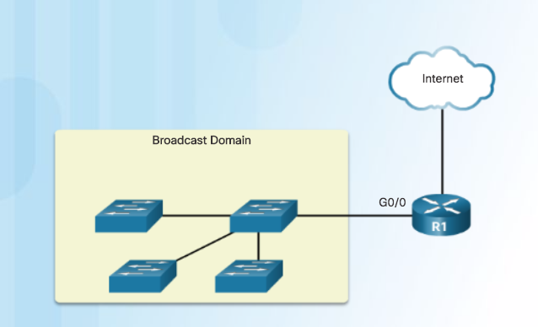
Network Segmentation Broadcast Domains
Devices use broadcasts in an Ethernet LAN to locate:
Other devices - Address Resolution Protocol (ARP) which sends Layer 2 broadcasts to a known IPv4 address on the local network to discover the associated MAC address.
Services – Dynamic Host Configuration Protocol (DHCP) which sends broadcasts on the local network to locate a DHCP server.
Switches propagate broadcasts out all interfaces except the interface on which it was received.
Notes:
8.1 – Subnetting an IPv4 Network
8.1.1 – Network Segmentation
8.1.1.1 – Broadcast Domains

Slide 38
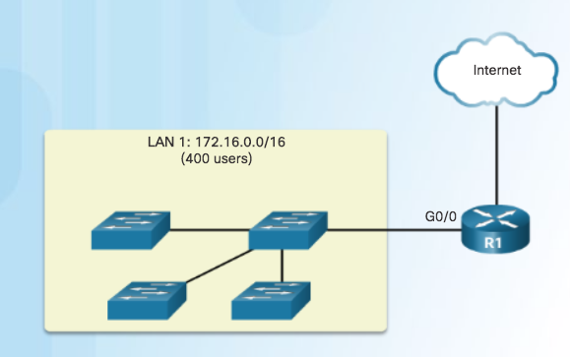
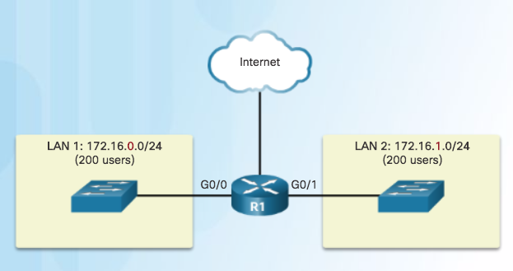
Network Segmentation Problems with Large Broadcast Domains
Hosts can generate excessive broadcasts and negatively affect the network.
Slow network operations due to the significant amount of traffic it can cause.
Slow device operations because a device must accept and process each broadcast packet.
Solution: Reduce the size of the network to create smaller broadcast domains. These smaller network spaces are called subnets.
One Broadcast Domain
Broadcast in LAN 1 contained in 1 subnet
Broadcast in LAN 2 contained in 1 subnet
Notes:
8.1 – Subnetting an IPv4 Network
8.1.1 – Network Segmentation
8.1.1.2 – Problems with Large Broadcast Domains

Slide 39
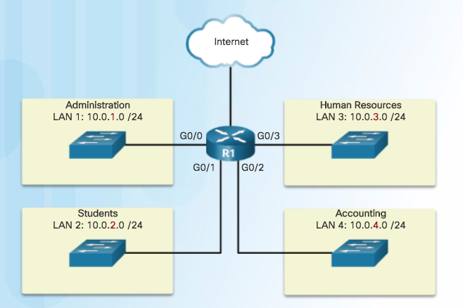
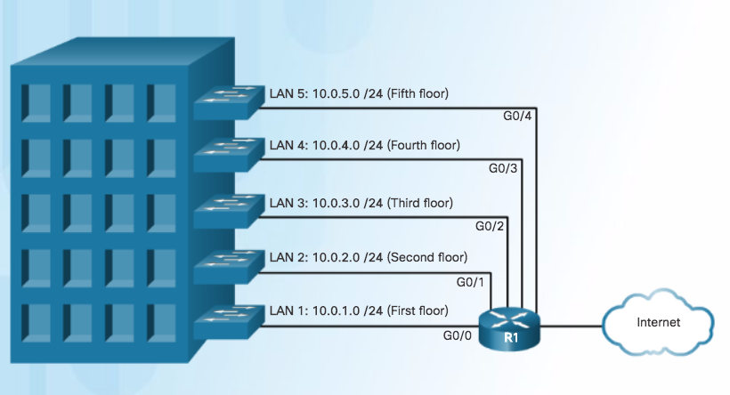
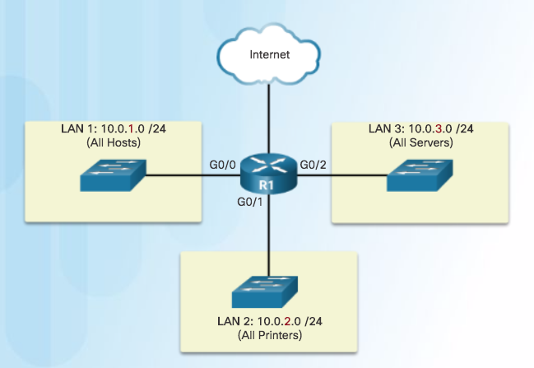
Network Segmentation Reasons for Subnetting
Reduces overall network traffic and improves network performance.
Enables an administrator to implement security policies such as which subnets are allowed or not allowed to communicate together.
Communicating between
Networks
Subnetting by Location
Subnetting by Device Type
Notes:
8.1 – Subnetting an IPv4 Network
8.1.1 – Network Segmentation
8.1.1.2 – Reasons for Subnetting

Slide 40
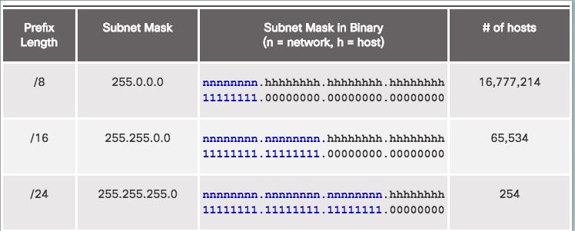
Subnetting an IPv4 Network Octet Boundaries
Networks are most easily subnetted at the
octet boundary of /8, /16, and /24
Prefix length and the subnet mask are different ways of identifying the network portion of an address.
Subnets are created by borrowing host bits for network bits.
More host bits borrowed, the more subnets that can be defined.
Notes:
8.1 – Subnetting an IPv4 Network
8.1.2 – Subnetting an IPv4 Network
8.1.2.1 – Octet Boundaries

Slide 41
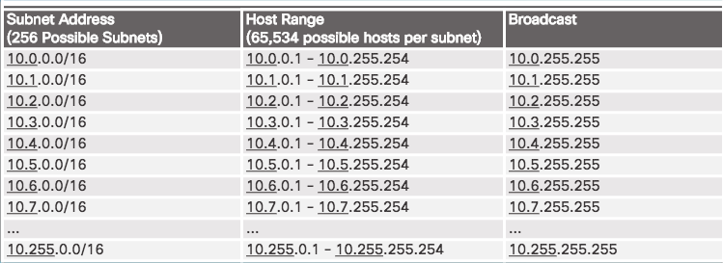
Subnetting an IPv4 Network Subnetting on the Octet Boundary
Subnetting Network 10.x.0.0/16
Define up to 256 subnets with each subnet capable of connecting 65,534 hosts.
First two octets identify the network portion while the last two octets are for host IP addresses.
Notes:
8.1 – Subnetting an IPv4 Network
8.1.2 – Subnetting an IPv4 Network
8.1.2.2 – Subnetting on the Octet Boundary

Slide 42
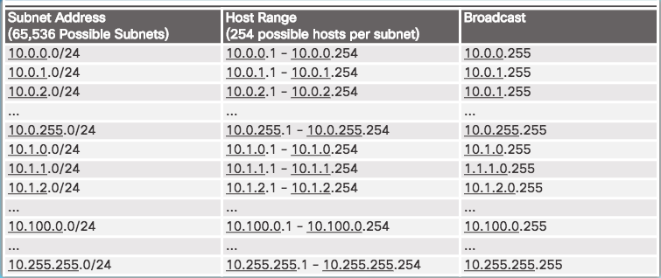
Subnetting an IPv4 Network Subnetting on the Octet Boundary (Cont.)
Subnetting Network 10.x.x.0/24
Define 65,536 subnets each capable of connecting 254 hosts.
/24 boundary is very popular in subnetting because of number of hosts.
Notes:
8.1 – Subnetting an IPv4 Network
8.1.2 – Subnetting an IPv4 Network
8.1.2.2 – Subnetting on the Octet Boundary

Slide 43
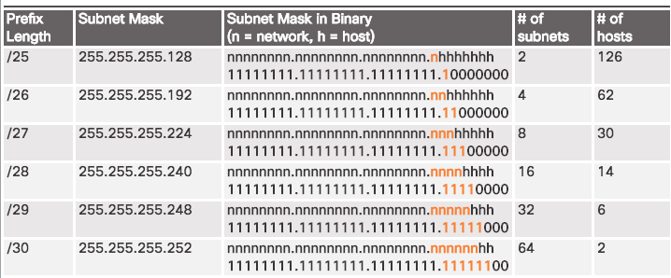
Subnetting an IPv4 Network Classless Subnetting
Subnetting a /24 Network
Subnets can borrow bits from any host bit position to create other masks.
Notes:
8.1 – Subnetting an IPv4 Network
8.1.2 – Subnetting an IPv4 Network
8.1.2.3 – Classless Subnetting

Slide 44
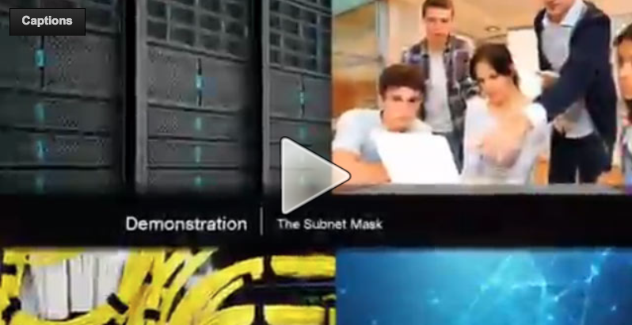
Subnetting an IPv4 Network Video Demonstration – The Subnet Mask
Subnetting in Binary
ANDING
Convert IP address and Subnet Mask to Binary (line up vertically like an addition problem)
Logically AND (1 and 1 = 1, all other combinations = 0)
Result is network address for original IP address
Classful Subnetting
Class A /8 255.0.0.0
Class B /16 255.255.0.0
Class C /24 255.255.255.0
Notes:
8.1 – Subnetting an IPv4 Network
8.1.2 – Subnetting an IPv4 Network
8.1.2.4 – Video – The Subnet Mask

Slide 45
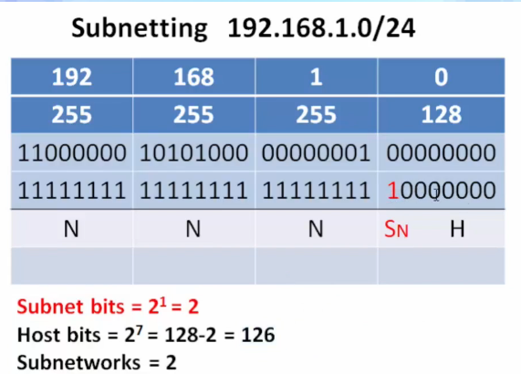
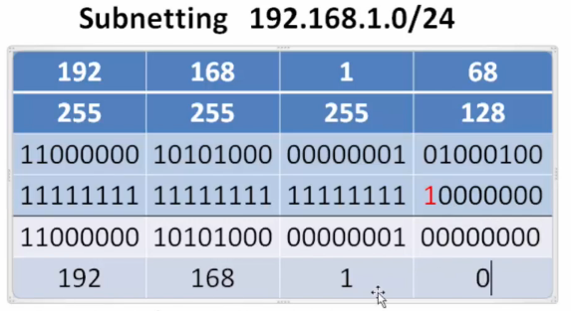
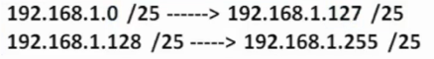
Subnetting an IPv4 Network The Subnet Mask (Cont.)
Notes:
8.1 – Subnetting an IPv4 Network
8.1.2 – Subnetting an IPv4 Network
8.1.2.4 – Video – The Subnet Mask

Slide 46
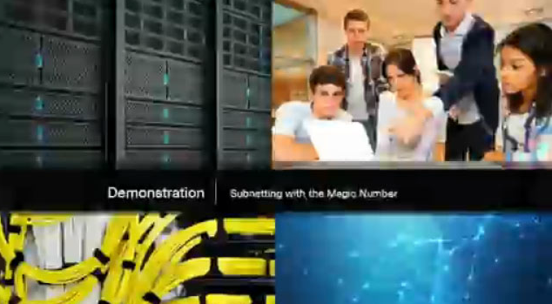
Subnetting an IPv4 Network Subnetting with the Magic Number
Magic number technique used to calculate subnets
Magic number is simply the place value of the last one in the subnet mask
/25 11111111.11111111.11111111.10000000 magic number = 128
/26 11111111.11111111.11111111.11000000 magic number = 64
/27 11111111.11111111.11111111.11100000 magic number = 32
Notes:
8.1 – Subnetting an IPv4 Network
8.1.2 – Subnetting an IPv4 Network
8.1.2.5 – Video – Subnetting with the Magic Number

Slide 47
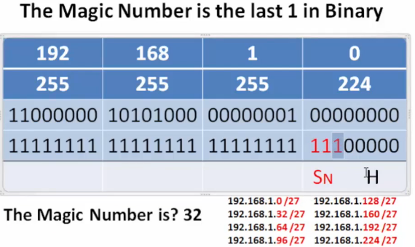
Subnetting an IPv4 Network Video Demonstration – Subnetting with the Magic Number (Cont.)
Notes:
8.1 – Subnetting an IPv4 Network
8.1.2 – Subnetting an IPv4 Network
8.1.2.5 – Video – Subnetting with the Magic Number

Slide 48

Subnetting an IPv4 Network Subnetting with the Magic Number (Cont.)
Notes:
8.1 – Subnetting an IPv4 Network
8.1.2 – Subnetting an IPv4 Network
8.1.2.5 – Video – Subnetting with the Magic Number

Slide 49


Subnetting an IPv4 Network Classless Subnetting Example
Notes:
8.1 – Subnetting an IPv4 Network
8.1.2 – Subnetting an IPv4 Network
8.1.2.6 – Classless Subnetting Example

Slide 50


Subnetting an IPv4 Network Creating 2 Subnets
/25 Subnetting Topology
Notes:
8.1 – Subnetting an IPv4 Network
8.1.2 – Subnetting an IPv4 Network
8.1.2.7 – Creating 2 Subnets

Slide 51



Subnetting an IPv4 Network Creating Two Equal-sized Subnets (/25)
Create 2 Equal-sized Subnets from 192.168.1.0 /24
Subnet Mask - 11111111.11111111.11111111.10000000
Magic Number = 128
192.168.1.0 /25 (start at 0)
192.168.1.128 /25 (Add 128)
Notes:
8.1 – Subnetting an IPv4 Network
8.1.2 – Subnetting an IPv4 Network
8.1.2.8 – Video Demonstration – Creating Two Equal-sized Subnets (/25)

Slide 52


Subnetting an IPv4 Network Subnetting Formulas
Calculate Number of Subnets Formula
Subnetting a /24 Network
Notes:
8.1 – Subnetting an IPv4 Network
8.1.2 – Subnetting an IPv4 Network
8.1.2.9 – Subnetting Formulas

Slide 53


Subnetting an IPv4 Network Subnetting Formulas (Cont.)
Calculate Number of Hosts Formula
Calculating the Number of Hosts
Notes:
8.1 – Subnetting an IPv4 Network
8.1.2 – Subnetting an IPv4 Network
8.1.2.9 – Subnetting Formulas

Slide 54



Subnetting an IPv4 Network Creating 4 Subnets
/26 Subnetting Topology
Notes:
8.1 – Subnetting an IPv4 Network
8.1.2 – Subnetting an IPv4 Network
8.1.2.10 – Creating 4 Subnets

Slide 55

Subnetting an IPv4 Network Creating 4 Subnets (Cont.)
/26 Subnetting Topology
Notes:
8.1 – Subnetting an IPv4 Network
8.1.2 – Subnetting an IPv4 Network
8.1.2.10 – Creating 4 Subnets

Slide 56

Subnetting an IPv4 Network Creating 4 Subnets (Cont.)
/26 Subnetting Topology
Notes:
8.1 – Subnetting an IPv4 Network
8.1.2 – Subnetting an IPv4 Network
8.1.2.10 – Creating 4 Subnets

Slide 57

Subnetting an IPv4 Network Video Demonstration – Creating Four Equal-sized Subnets (/26)
Create 4 Equal-sized Subnets from 192.168.1.0 /24
Subnet Mask in Binary – 11111111.11111111.11111111.11000000
2^2 = 4 Subnets
Magic Number = 64
192.168.1.0 /26
192.168.1.64 /26
192.168.1.128 /26
192.168.1.192 /26
Notes:
8.1 – Subnetting an IPv4 Network
8.1.2 – Subnetting an IPv4 Network
8.1.2.11 – Video Demonstration – Creating Four Equal-sized Subnets (/26)

Slide 58

Subnetting an IPv4 Network Video Demonstration – Creating Eight Equal-sized Subnets (/27)
Create 8 Equal-sized Subnets from 192.168.1.0 /24
Borrow 3 bits – 11111111.11111111.11111111.11100000
Magic Number = 32
192.168.1.0 /27 (Start at 0)
192.168.1.32 /27 (Add 32 to previous network)
192.168.1.64 /27 (Add 32)
192.168.1.96 /27 (Add 32)
192.168.1.128 /27 (Add 32)
192.168.1.160 /27 (Add 32)
192.168.1.192 /27 (Add 32)
192.168.1.224 /27 (Add 32)
Notes:
8.1 – Subnetting an IPv4 Network
8.1.2 – Subnetting an IPv4 Network
8.1.2.12 – Video Demonstration – Creating Eight Equal-sized Subnets (/27)

Slide 59

Subnetting a /16 and /8 Prefix Creating Subnets with a /16 prefix
Notes:
8.1 – Subnetting an IPv4 Network
8.1.3 – Subnetting a /16 and /8 Prefix
8.1.3.1 – Creating Subnets with a /16 prefix

Slide 60


Subnetting a /16 and /8 Prefix Creating 100 Subnets with a /16 prefix
Notes:
8.1 – Subnetting an IPv4 Network
8.1.3 – Subnetting a /16 and /8 Prefix
8.1.3.2 – Creating 100 Subnets with a /16 prefix

Slide 61


Subnetting a /16 and /8 Prefix Calculating the Hosts
Notes:
8.1 – Subnetting an IPv4 Network
8.1.3 – Subnetting a /16 and /8 Prefix
8.1.3.3 – Calculating the Hosts

Slide 62

Subnetting a /16 and /8 Prefix Video Demonstration – Creating One Hundred Equal-sized Subnets
An enterprise network requires 100 equal-sized subnets starting from 172.16.0.0/16
New Subnet Mask
11111111.11111111.11111110.00000000
2^7 = 128 Subnets
2^9 = 512 hosts per subnet
Magic Number = 2
172.16.0.0 /23
172.16.2.0 /23
172.16.4.0 /23
172.16.6.0 /23
…
172.16.254.0 /23
Notes:
8.1 – Subnetting an IPv4 Network
8.1.3 – Subnetting a /16 and /8 Prefix
8.1.3.4 – Video Demonstration – Creating One Hundred Equal-sized Subnets

Slide 63

Subnetting a /16 and /8 Prefix Creating 1000 Subnets with a /8 Network
Notes:
8.1 – Subnetting an IPv4 Network
8.1.3 – Subnetting a /16 and /8 Prefix
8.1.3.5 – Creating 1000 Subnets with a /8 Network

Slide 64



Subnetting a /16 and /8 Prefix Creating 1000 Subnets with a /8 Network (Cont.)
Notes:
8.1 – Subnetting an IPv4 Network
8.1.3 – Subnetting a /16 and /8 Prefix
8.1.3.5 – Creating 1000 Subnets with a /8 Network

Slide 65



Subnetting a /16 and /8 Prefix Video Demonstration – Subnetting Across Multiple Octets
New Challenge Problem: Create over 300 Equal-sized Subnets of 20,000 Hosts each starting from 10.0.0.0/8
Notes:
8.1 – Subnetting an IPv4 Network
8.1.3 – Subnetting a /16 and /8 Prefix
8.1.3.6 – Video Demonstration – Subnetting Across Multiple Octets

Slide 66

Subnetting to Meet Requirements Subnetting Based on Host Requirements
Notes:
8.1 – Subnetting an IPv4 Network
8.1.4 – Subnetting to Meet Requirements
8.1.4.1 – Subnetting Based on Host Requirements

Slide 67

Subnetting to Meet Requirements Subnetting Based On Network Requirements
Host devices used by employees in the Engineering department in one network and Management in a separate network.
Notes:
8.1 – Subnetting an IPv4 Network
8.1.4 – Subnetting to Meet Requirements
8.1.4.2 – Subnetting Based On Network Requirements

Slide 68



Subnetting to Meet Requirements Network Requirement Example
Notes:
8.1 – Subnetting an IPv4 Network
8.1.4 – Subnetting to Meet Requirements
8.1.4.3 – Network Requirement Example

Slide 69

Subnetting to Meet Requirements Network Requirement Example (Cont.)
Notes:
8.1 – Subnetting an IPv4 Network
8.1.4 – Subnetting to Meet Requirements
8.1.4.3 – Network Requirement Example

Slide 70



Benefits of Variable Length Subnet Masking Traditional Subnetting Wastes Addresses
Notes:
8.1 – Subnetting an IPv4 Network
8.1.5 – Benefits of Variable Length Subnet Masking
8.1.5.1– Traditional Subnetting Wastes Addresses

Slide 71


Benefits of Variable Length Subnet Masking Variable Length Subnet Masks (VLSM)
Traditional
Subnets of Varying Sizes
Notes:
8.1 – Subnetting an IPv4 Network
8.1.5 – Benefits of Variable Length Subnet Masking
8.1.5.2 – Variable Length Subnet Masks (VLSM)

Slide 72


Benefits of Variable Length Subnet Masking Basic VLSM
Basic Subnetting
Notes:
8.1 – Subnetting an IPv4 Network
8.1.5 – Benefits of Variable Length Subnet Masking
8.1.5.3 – Basic VLSM

Slide 73


Benefits of Variable Length Subnet Masking Video Demonstration – VLSM Basics
Basic VLSM
Subnets do not have to be equal sizes, as long as their address ranges do not overlap.
When creating subnets it is easier to work from larger to smaller.
Notes:
8.1 – Subnetting an IPv4 Network
8.1.5 – Benefits of Variable Length Subnet Masking
8.1.5.4 – Video Demonstration – VLSM Basics

Slide 74

Benefits of Variable Length Subnet Masking VLSM in Practice
Notes:
8.1 – Subnetting an IPv4 Network
8.1.5 – Benefits of Variable Length Subnet Masking
8.1.5.5 – VLSM in Practice

Slide 75

Benefits of Variable Length Subnet Masking VLSM Chart
Notes:
8.1 – Subnetting an IPv4 Network
8.1.5 – Benefits of Variable Length Subnet Masking
8.1.5.6 – VLSM Chart

Slide 76


Benefits of Variable Length Subnet Masking Video Demonstration – VLSM Example
Given the network 172.16.0.0 /23 creates subnets:
1 network for 200 hosts - 256
1 network for 100 hosts - 128
1 network for 50 hosts - 64
1 network for 25 hosts - 32
1 network for 10 hosts - 16
4 point-to-point networks for 2 hosts each – 4x4 = 16
/23 = 2^9 hosts = 512
256+128+64+32+16+16 = 512 hosts needed
Address range 172.16.0.0 – 172.16.1.255
172.16.1.248 /30 (4)
172.16.1.252 /30 (4)
Notes:
8.1 – Subnetting an IPv4 Network
8.1.5 – Benefits of Variable Length Subnet Masking
8.1.5.7 – Video Demonstration – VLSM Example

